Slide 1
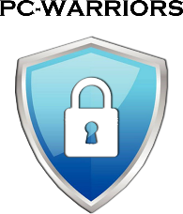
RMF BEYOND THEORY
Jose Neto
Cybersecurity Researcher
Lessons learned from a practitioner’s perspective

Slide 2
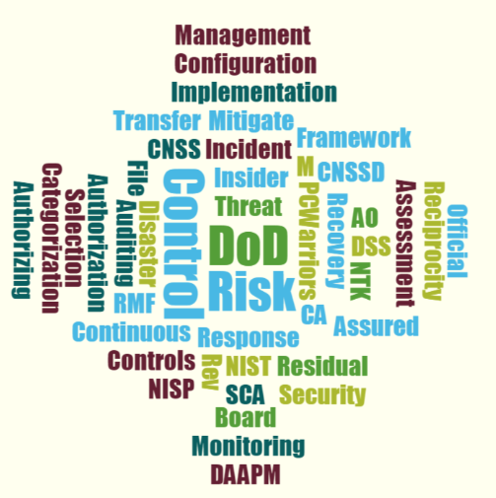
Agenda
Risk Management Framework

Slide 3
AGENDA
The objectives of the RMF process
RMF artifacts and their significance
Deploying an effective Continuous Monitoring Program
(Hands-on Security Demonstration)

Slide 4
What is the Risk Management Framework (RMF)?
NIST - The selection and specification of security controls for a system is accomplished as part of an organization-wide information security program that involves the management of organizational risk
The effective mitigation of existing/residual risk, through the implementation of administrative & technical security controls; proactively maintained through continuous monitoring.
Continuous Monitoring

Slide 5
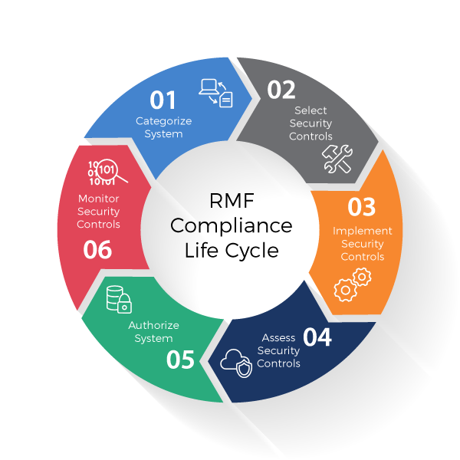
RMF Lifecycle
DSS – 388 possible security controls for a M-L-L system.
DoD – 2000+ security controls for a H-H-H system.
Weekly, Monthly, Quarterly, Semi-Annual and Annual requirements for Continuous Monitoring.
Steps 3 & 6 are complex

Slide 6
Weekly CONMON Responsibilities
AC-6 (9) | Least Privilege | Auditing Use Of Privileged Functions | Weekly
AC-17 | Remote Access | Weekly
AC-17 (1) | Remote Access | Automated Monitoring/Control | Weekly
AC-17 (2) | Remote Access | Protection Of Confidentiality/Integrity Using Encryption | Weekly
AC-17 (3) | Remote Access | Managed Access Control Points | Weekly
AC-17 (4) | Remote Access | Privileged Commands/Access | Weekly
AC-17 (6) | Remote Access | Protection Of Information | Weekly
AC-17 (9) | Remote Access | Disconnect/ Disable Access | Weekly
AU-6 | Audit Review, Analysis, And Reporting | Weekly
CP-9 | Information System Backup | Weekly
SI-2 | Flaw Remediation | Weekly
SI-3 | Malicious Code Protection | Weekly
SI-3 (2) | Malicious Code Protection | Automatic Updates | Weekly
SI-3 (10) | Malicious Code Protection | Malicious Code Analysis | Weekly
Required CONMON

Slide 7
RMF objectives from the DAAPM
a. Incorporating cybersecurity early and robustly in the acquisition and system development life cycle.
c. Providing a risk management methodology that gives organizations a true picture of vulnerabilities caused by non-compliant controls as it relates to other risk factors (e.g. likelihood, threat, and impact).
e. Emphasizing information security continuous monitoring and timely correction of deficiencies, including active management of vulnerabilities and incidents.
RMF objectives pg. 16 DAAPM

Slide 8
The pathway to RMF Authorization
Coordinate the respective DD254, and discuss the system’s categorization and SCG. (SSP - System Information, Appendices)
Identify all the Government POCs as well as the local contacts that will be involved with the system lifecycle. (SSP, RAR)
Conduct detailed risk study and gap analysis of all the security controls needed to establish and maintain compliance. (SSP – Security Controls, CONMON)
RMF Artifacts – Approx. 200 Pages

Slide 9
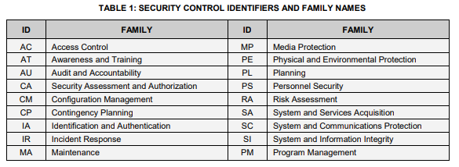
NIST 800-53/A Rev4
18 Security control families

Slide 10
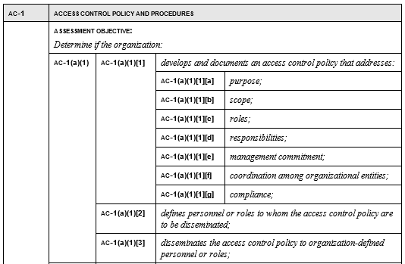
AC-1 Access Control
Assessment guidelines

Slide 11
AC-1 Access Control Family
The purpose of the Access Control family is a series of controls that determine the settings used for limiting access to systems and information stored on the systems. -Some of the controls provide guidance on account management and privilege assignments. The guidance provided helps to address the assignment of roles and define business functions. Other settings covered include login time, screen saver requirements, and similar activity-based controls. The scope of this policy governs both physical and electronic access to DSS authorized/accredited resources within the organization. The roles & responsibility of this policy is primarily assigned to the ISSM/ISSO, but all cleared personnel with NTK are responsible for maintaining and monitoring continuous compliance. Commitment - Senior management in the organization are aware of the resources needed to coordinate with other organizational entities for standard compliance across the enterprise. This policy is currently compliant by the enforcement of the following AC (1-25) security controls.
Security Control Narrative

Slide 12
RMF Appendices
System/Network Diagram
Facility Layout
Hardware/Software List
DSS form147
IS Access forms
Upgrade/Downgrade procedures
Maintenance log
Assured File Transfers
Contingency Plan
Incident Response Plan
Plan of Action & Milestones
Risk Assessment Report
Mobility System Plan
Variances, DD254, Insider Threat Program, etc.

Slide 13
Deploying an effective Continuous Monitoring Program
Think like a hacker, act like an ISSM
Hands-on Security Demonstration

Slide 14
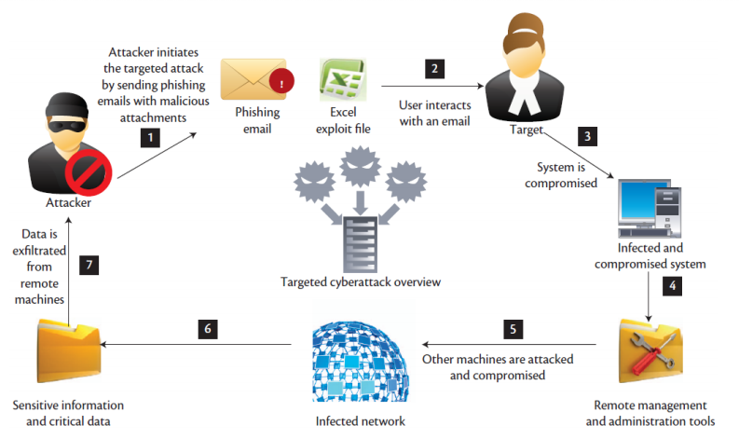
Advanced Persistent Threats (APT)
Attacks in which an unauthorized entity gains access to a network or resource and stays there undetected for a long period of time.
Severe Impact

Slide 15
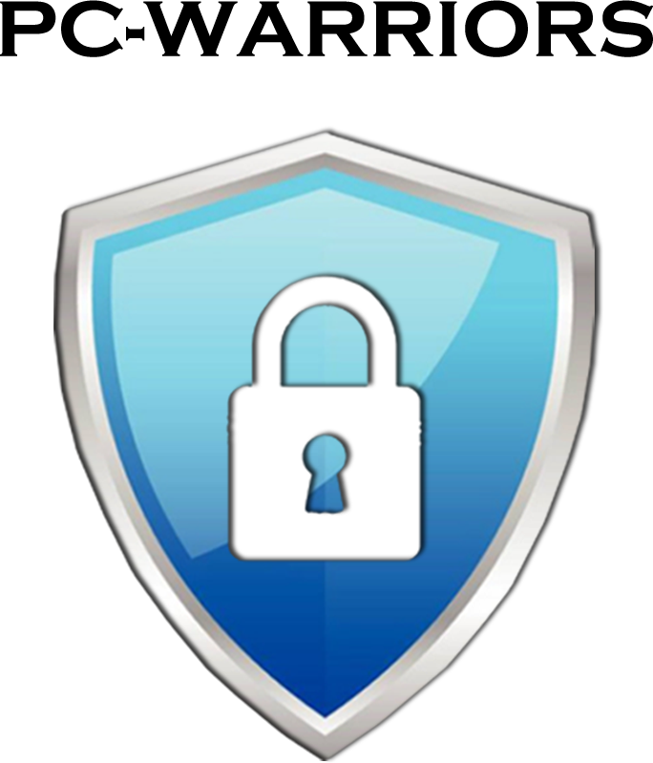
Questions? Comments?
Jose Neto
JNeto@PC-Warriors.com
407-715-7392

